Slide 1

THE ADVANTAGE
Together we provide the solution that favors your bottom line and increases productivity…
Lead Acid
(Current Solution)
Li-Ion
Flow
Warranty | Up to 10 Years with Limited Capacity Warranty | 3 years |  | 10 years with no EOL degradation (Extendable with limited throughput caps) | Maximum Value
Energy Density | 100-296 Wh/kg | 500-100 Wh/kg | 35-70 Wh/kg | 250+Wh/kg | Among the highest
Chemistry | Electrochemical | Electrochemical | Electrochemical | Electrostatic | No degradation
DC round-trip Efficiency | 80-93% | 70% | 65-75% | 99% | Low Opex
Depth of Discharge | 70-80% | 50-60% | 100% | 100% | Full Capacity
Exposure to Extreme Temps | <50°C | <27°C | <50°C | <60°C | Virtually any location
Charge Current Min-Max Voltage | Severely Limited 3.7v to 4 v | Severely Limited 12.23v to 12.89v | Severely Limited N/A | 1C-2C (up to 15C) 43.2v to 60.8v | Fast charging
Discharge Current Duration | 2-4 hrs | 10-20 hrs | 2-10 hrs | 1C-2C | Long Duration
No. of Cycles | 6000 (max) | 3000 (max) | 25000-50000 cycles | 25000-50000 cycles (4 cycles a day) | Long Product Life
Applications | Short duration | Short duration | Medium to long duration | Short, medium, and long duration | Wide applicability
The opportunity with Solutions is that our battery will charge faster, provide more efficient battery management, and has the ability to convert soon-to-be retired assets into productive resources

Slide 2
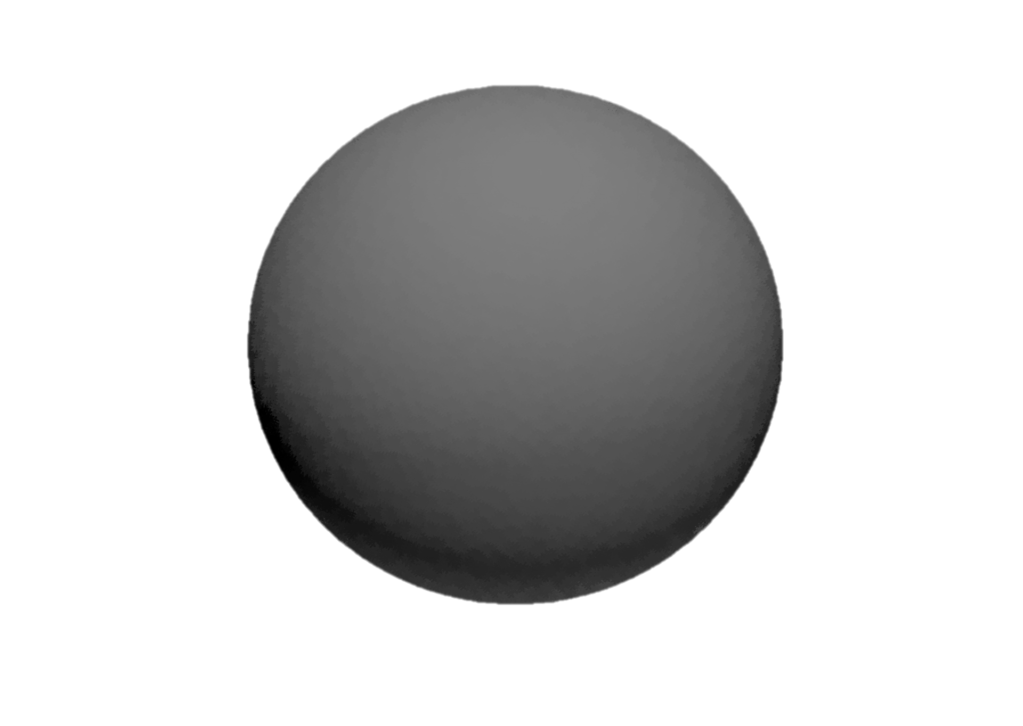

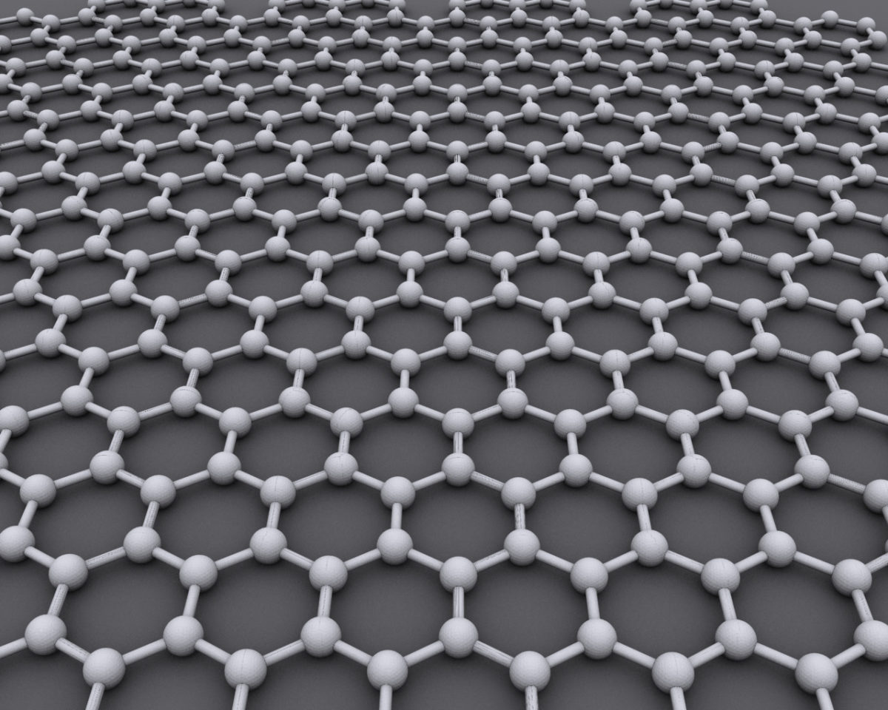
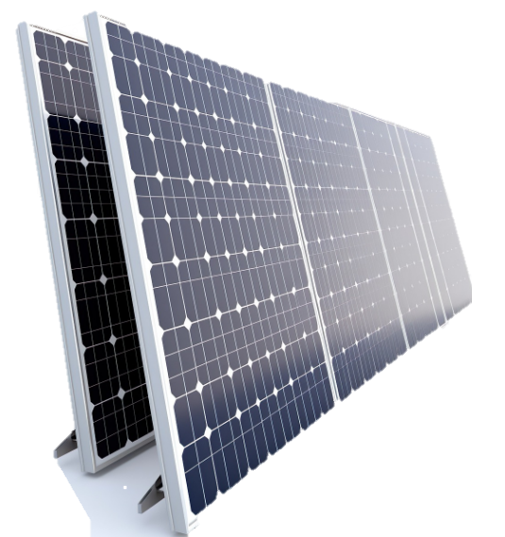
ADVANCED EMISSIONS REDUCTION SYSTEMS (ERS)
Power Generation
Solar Array
Diesel Gensets
Wind
Grid Tied
Advanced Energy Storage
Stores Electrostatically
Non-Chemical
Charges/Discharges Fast
15,000+ Life Cycles
99%+ round Trip Efficiency
Intrinsically Safe
Energy Delivery
Back Up Power-UPS
Demand Management
Off Grid
EV Charging
Hybrid Delivery

Slide 3





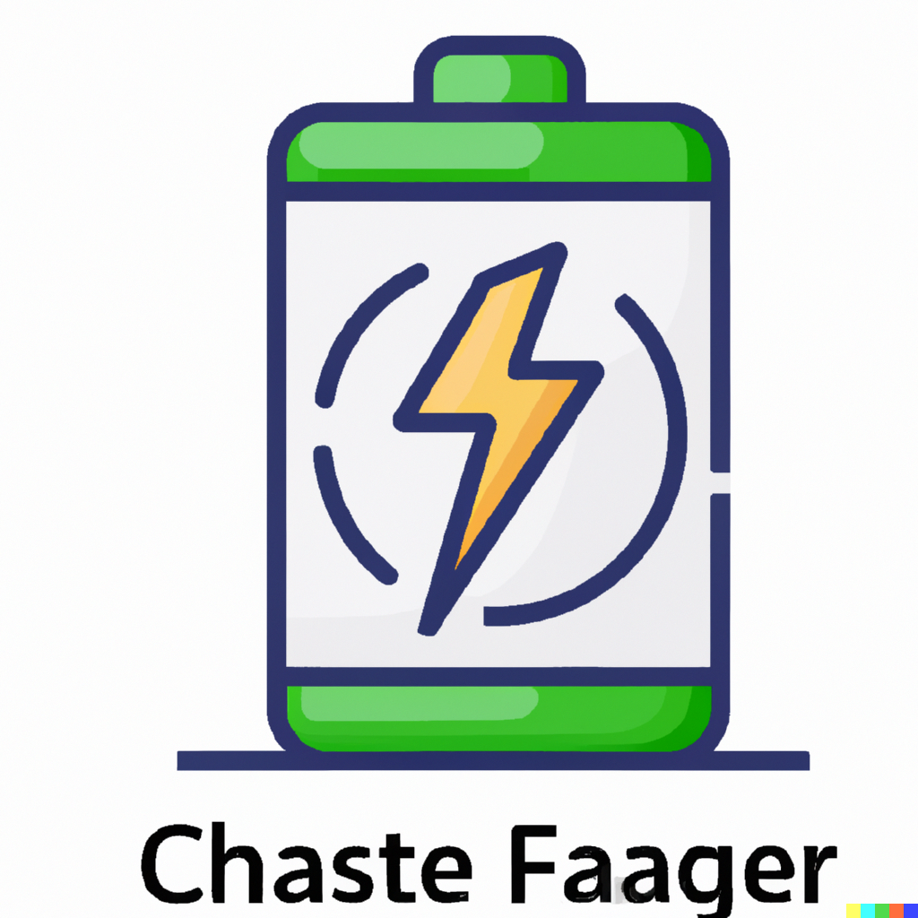






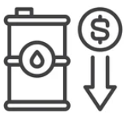

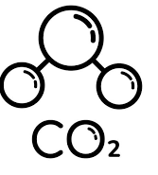
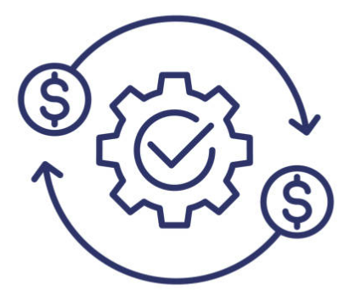

BENEFITS OF AN EMISSIONS REDUCTION SYSTEM (ERS)
Longest Life Cycle in the Industry
Fast charge functionality eliminates the need to carry extra battery stock
No capacity degradation due to cycling – delivers consistent equipment availability throughout the day
-10°C to 55°C operating temperature range eliminates the need for temperature compensation
Fast charge functionality enables continuous equipment availability during shifts – delivering higher productivity and capex savings
Expanded EV Fleet Utilization
No risk of thermal runaway
Significantly less nominal capacity installed per truck compared to chemical batteries
Energy Cost Reductions
Vibration and shock proof
Genset Fuel Cost Reductions
Environmentally friendly – no disposal impact. Fully recyclable
Emission Reductions
High round-trip efficiency
Grid Independence

Slide 4






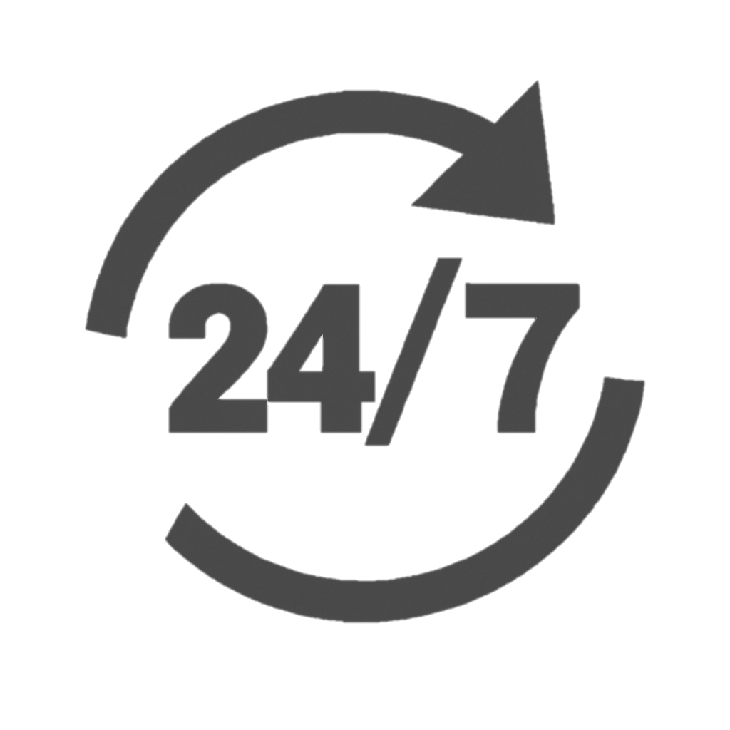

EMS AFFORDABILITY
COLD STORAGE
EMISSIONS REDUCTION SYSTEM (ERS) IMPLEMENTATION PATHWAY
MOBILE POWER BANKS
ELECTRIC VEHICLE CHARGING
EaaS
DATA ANALYTICS
FORKLIFTS
CHARGING
GOAL
DESIGN
COMMISSION
MAINTENANCE
PLAN
INSTALL
MONITOR 24/7
SERVICE
Advancements in technology and manufacturing processes have led to cost reductions in components and equipment used in ERS, making our solution more accessible to a broader range of businesses.

Slide 5

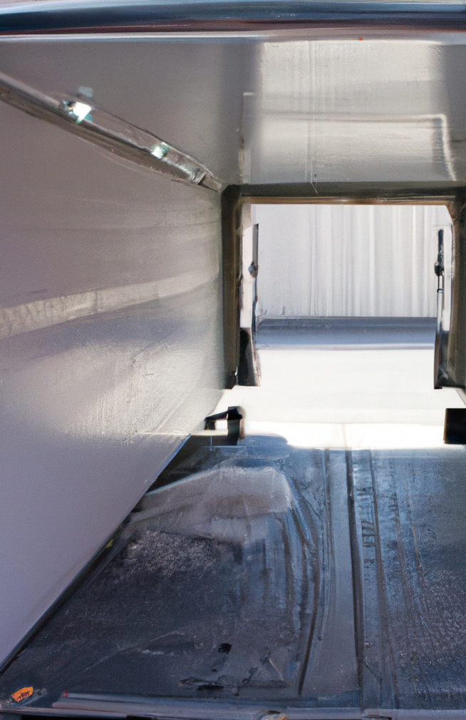

COLD CHAIN VERTICAL
CAN REDUCE YOUR ELECTRICITY COSTS
BY
ANNUALLY
Installing solar to generate power that is stored and then deployed/discharged to sufficiently supply enough energy to power your facilities between 2 pm through 7 pm (peak times).
20%-50%
Most commercial clients are charged at a rate representing almost 50% of their electricity cost which is directly associated with the power they consumed from the utility company (grid) during peak times. By using our supercapacitor battery to run your facility during peak hours you are now reducing your total cost of operations on a 24-hours basis.
PROBLEM
SOLUTION
technology
20%
^{SAVINGS}
50%
^{SAVINGS}
Utilizing the best technology, including Tier 1 solar panels and Hybrid Solid-State energy storage Supercapacitor Modules that store electricity electrostatically: not chemically.
Power Purchase Option
Cash Purchase Option

Slide 6

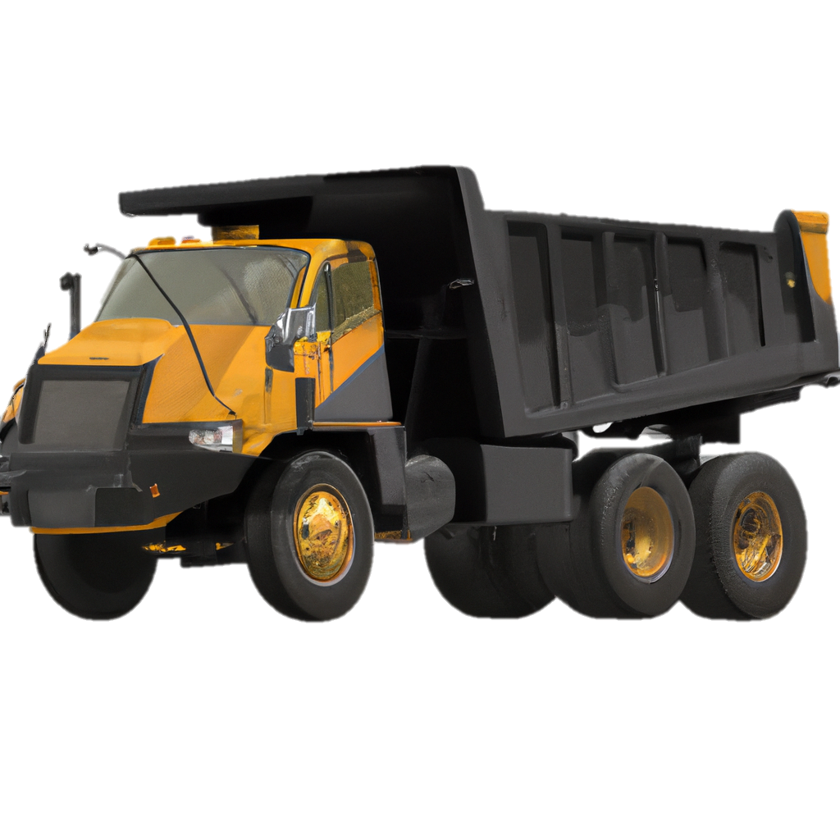
BESS – Battery Energy Storage System
Relocation Emergency Sites
Commercial and Industrial Sites
Renewable Energy Microgrids
/ FLEET APPLICATIONS
Emission Reduction Service
Light Towers
Construction Sites
Highway Repair
EV Charging Service
Campuses
Warehousing and Distribution
Commercial and Industrial Sites

Slide 7
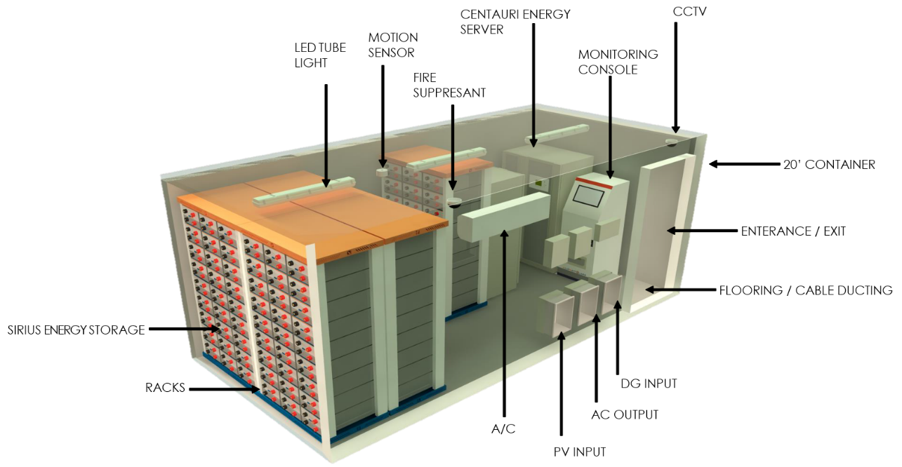
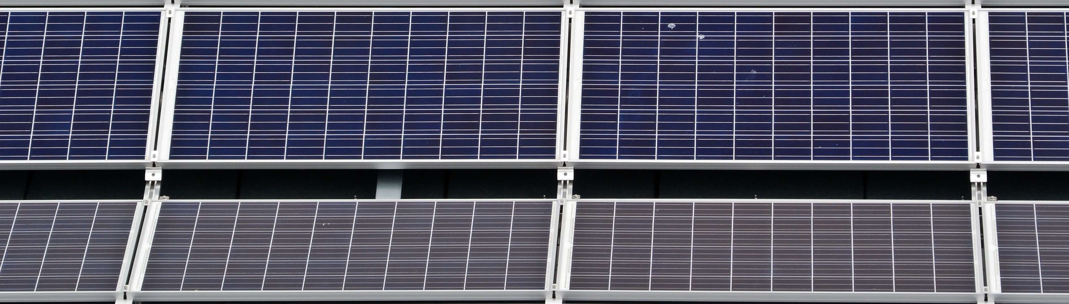
Containerized Solutions
ENERGY
BESS solutions are available for deployment as Engineered Equipment Packages (EEPs). They come in a variety of standard configurations based on power and energy ratings but can also be tailored to specific customer requirements. Each BESS package includes all batteries, inverters, battery management systems, and energy management systems required for standalone operation.
SUPPRESSANT
ENTRANCE / EXIT
Packages available:
10’ container – 240 kWh
20’ container – 1 MWh
40’ container – 4MWh

Slide 8
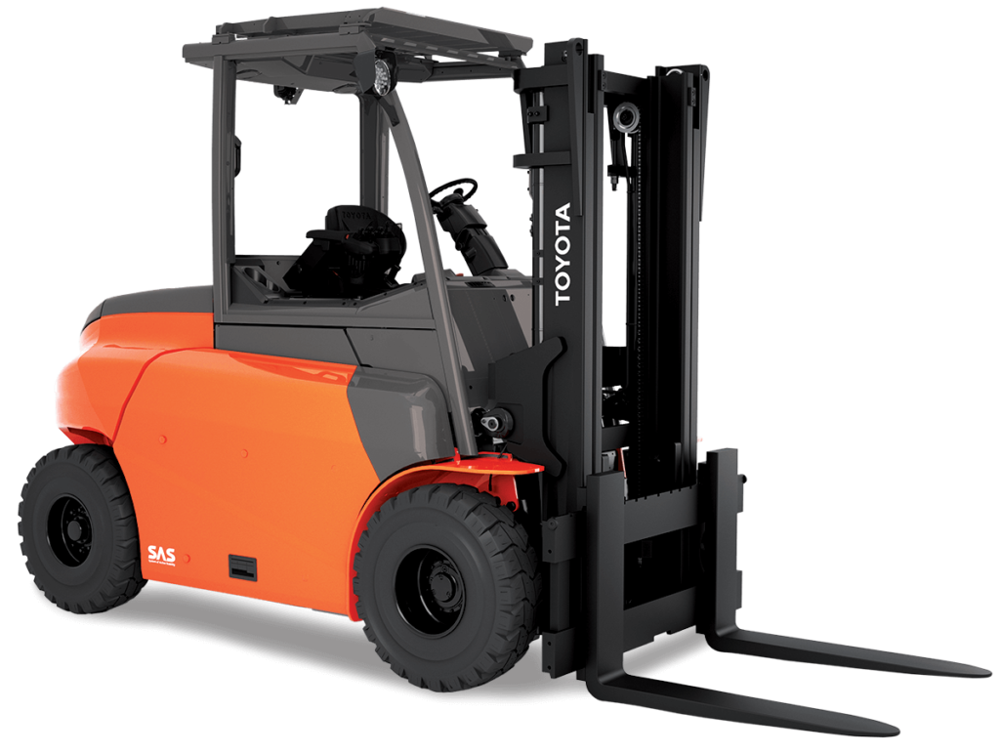
Forklift Solutions
Alignment partner with for the conversion and maintenance to our supercapacitor battery vs lithium-ion battery.
The high electrical conductivity of graphene batteries allows for faster energy transfer, resulting in improved performance
Enhanced acceleration
Improved lifting capacity
Overall operational efficiency
Graphene batteries can be charged at a much faster rate compared to conventional lithium-ion batteries.
Reduces downtime of forklifts during charging
Improves productivity and efficiency in material handling operations
These batteries have significantly higher energy density than traditional solutions. The store more energy in a smaller, lighter package.
Allows for longer operating times for forklifts before the need to recharge

Slide 9
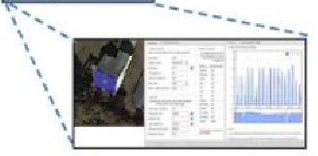
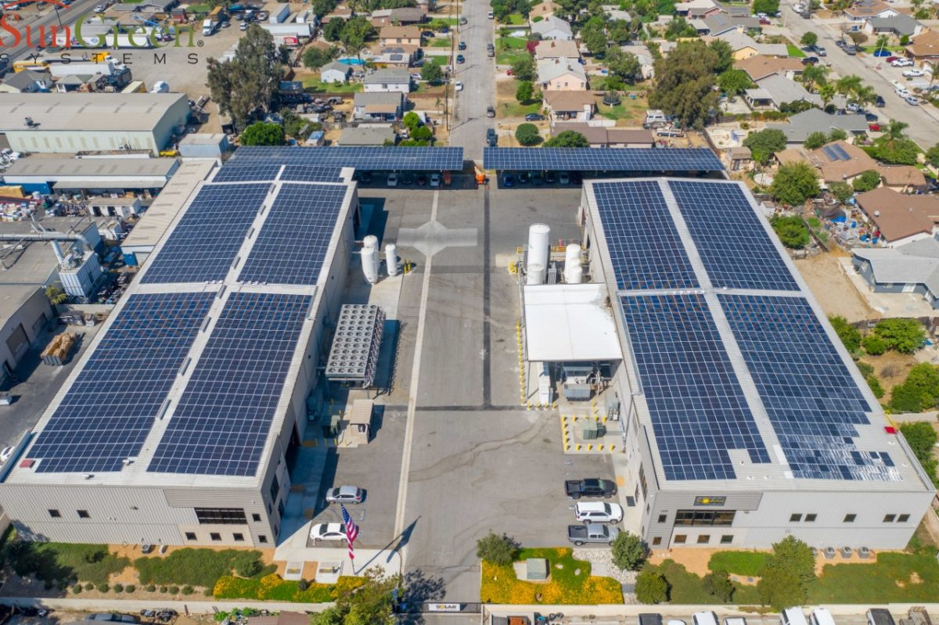
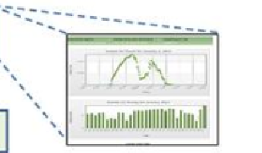
POINTS OF INTERACTION WITH /
Step 1
Grant Application/IRA
Site Evaluation
Prospective Customer
Proposal Preparation
Step 1
Forecast # units, install date
Step 2
Contract Signed
Step 2
Contract # units, date
Step 3
Design Review Prior to Submission for Permitting
Step 3
Design & Engineering
Permitting and Plan Review
(Utility & AHJ)
Step 4
Monitoring Setup
Step 4
Step 5
Maintenance
Installation
Inspection
Monitoring & Commissioning
Owner’s Manual
Step 5
Maintenance

Slide 10
Why This Works
Inflation Reduction Act (IRA)
  Enacts historic deficit reduction to fight inflation
  Lowers energy costs, increases cleaner production, and reduces carbon emissions by roughly 40 percent by 2030
  Allows Medicare to negotiate drug prices and caps out-of-pocket costs to $2,000 • Lowers ACA health care premiums for millions of Americans
  Make biggest corporations and ultra-wealthy pay their fair share
  There are no new taxes on families making $400,000 or less and no new taxes on small businesses – we are closing tax loopholes and enforcing the tax code.
  30%-50% investment tax credit based on application
Leveraging the / Alignment
  Providing a conversion methodology for forklifts
  Assisting in creating an electrification plan as companies address electric assets into their fleet portfolios
An Intake of Your Existing Business Processes
  Entire plan of how we can assist your company
  Turnkey solution on your service, maintenance, installations, conversions, and electrification plans through one company
Types of Companies We Work Well With
  Cold Storage
  Forklifts and Warehousing Environments
  Companies with EV Charging Strategies
  Metro and Rural clients
  Mobile Fleet companies
  Rock Crushing Facilities
  Oil and Gas Applications

